Slide 1
TSM Stock Prediction
Hsing-Chen (Tony) Lin

Slide 2
Introduction
The primary goal is to apply advanced machine learning techniques to predict the future stock prices and movements of TSM. Taiwan Semiconductor Manufacturing Company(TSM) is a leading global manufacturer of semiconductors, renowned for its advanced microchip production.

Slide 3
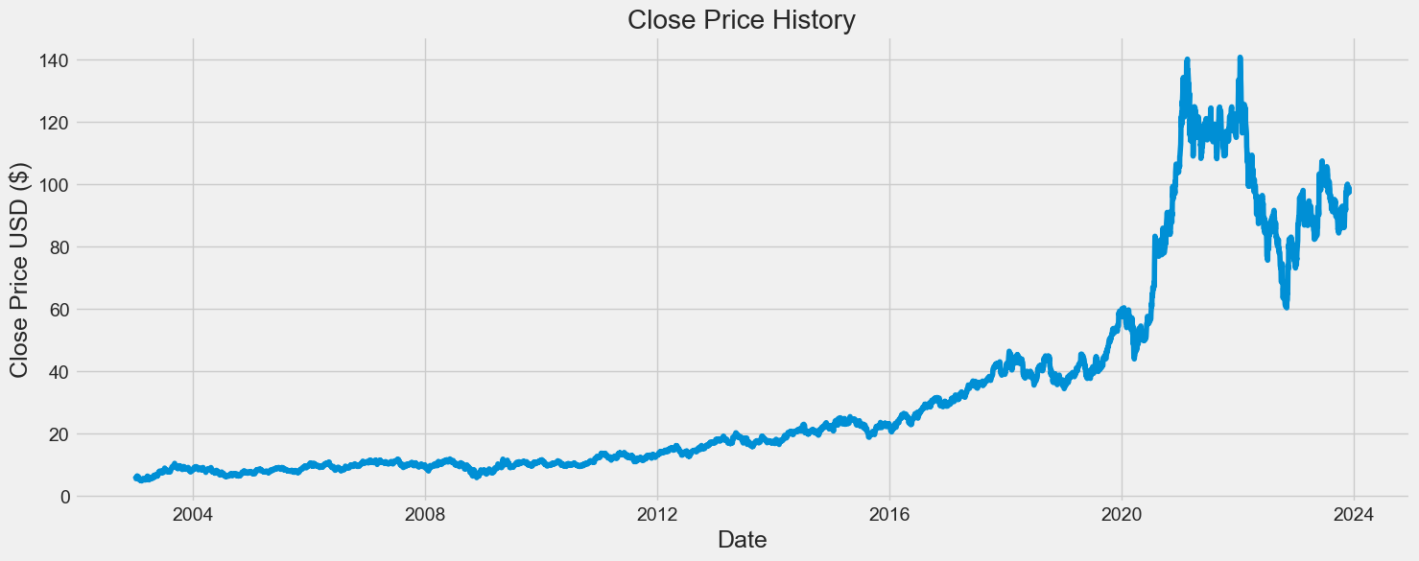
Why TSM?
Historical Growth: "TSM's stock has shown stable growth from 2003 to 2020."
Recent Volatility: "A noticeable shift towards increased volatility observed from 2020 to 2024."

Slide 4
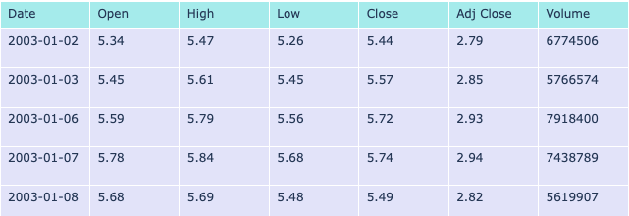
The Dataset
Time Frame: Coverage from January 2, 2003, to November 30, 2023. (Source: TSM (2003 - 2023) )
Attributes: Key data points like Open, High, Low, Close, Adj Close, Volume.

Slide 5
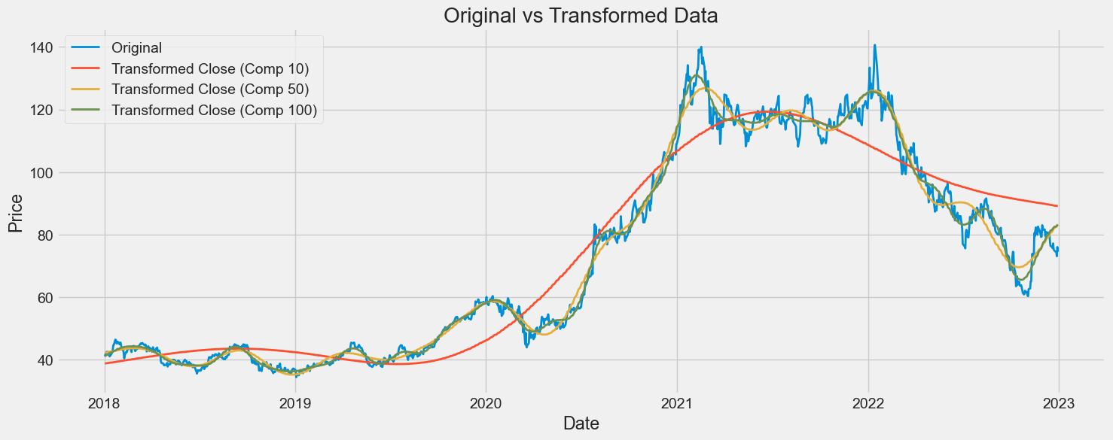
The Preprocessing of the Dataset
Technical Indicators: Integration of indicators like Moving Averages, MACD for enhanced analysis.
Fourier Transform: Application for trend analysis and noise reduction in 'Close' prices.

Slide 6
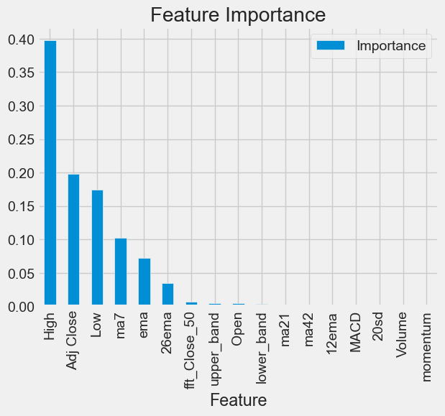
The Preprocessing of the Dataset
Feature Importance Analysis: Using XGBoost to identify significant predictors.
Dimensionality Reduction(Autoencoder): Employing an autoencoder to compress and simplify the data.

Slide 7
How to train our model?
Strategy: Sliding window approach for forecasting stock prices. Using the data from the past 60 days as the input value forecast the close price on the 61st day.
ex: 1-60 (Input) => 61 (Output)
2-61 (Input) => 62 (Output)
Model Architecture: Combination of CNN for extracting patterns and LSTM for analyzing time-series data.

Slide 8
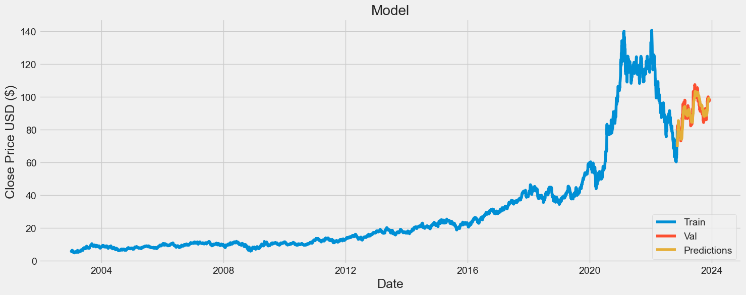
Results
RMSE: 3.163 (The Root Mean Square Error measures the average magnitude of the errors between predicted values and actual values).
accuracy: 0.81 (Predicted values were expected to fall within a range of plus or minus five units from the actual stock prices).
ex: 55 (Target Value) => 50 - 60 (Output Value) => accurate

Slide 9
Conclusion
The Challenge of Accurate Stock Price Prediction
Providing Indicators for Informed Stock Market Analysis

Slide 10
Thank you!

